Slide 1
Research question
Should we hide batch information in data analyses?

Slide 2
3 main questions
Was there any over-correction?
Which genes were most affected by the correction?

Slide 3
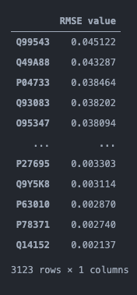
Genes most affected by non-class specific batch correction

Slide 4
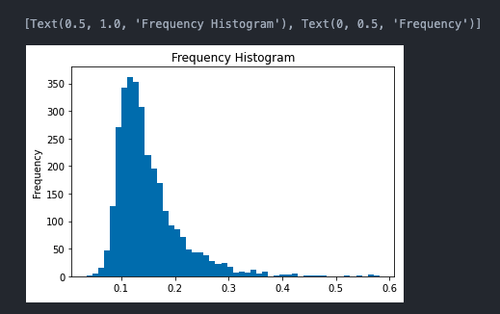
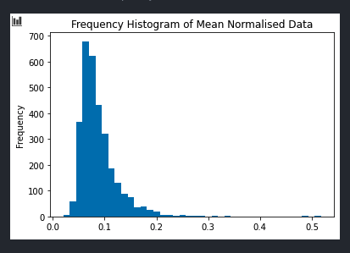
RMSE value distribution of non-normalized versus normalized batch correction
(Mean normalization)
Non-Mean Normalized
Mean Normalized

Slide 5
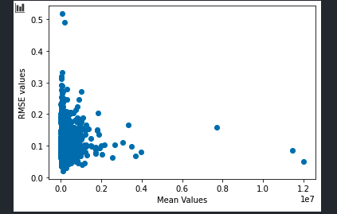
Scatterplot of the normalized RMSE values vs mean values
Extent of batch correction were not correlated with the mean values
Even at greater mean values, the extent of correction was low
Majority of batch correction was on the lower mean values

Slide 6
Non-Batch Corrected
Before MTC: 1959
After MTC: 505
Enriched: 83
Batch Corrected
Before MTC: 1770
After MTC: 486
Enriched: 69
Class Specific
Batch Corrected
Before MTC: 1747
After MTC: 480
Enriched: 44
CS Quantile Normalization + CS Batch Corrected
Before MTC: 1953
After MTC: 615
Enriched: 147

Slide 7

Jaccard Index of T-test p values

Slide 8
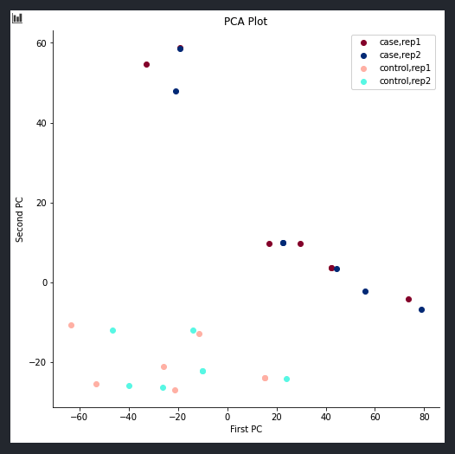
Non-Batch Corrected Data

Slide 9
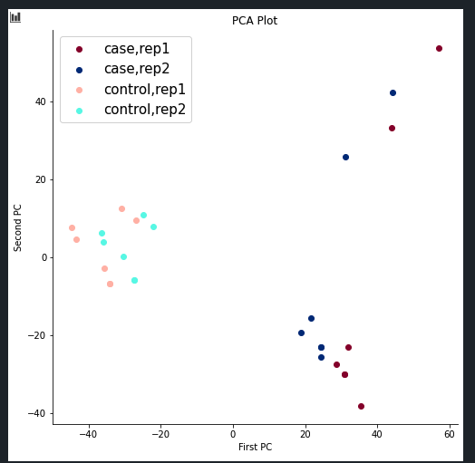
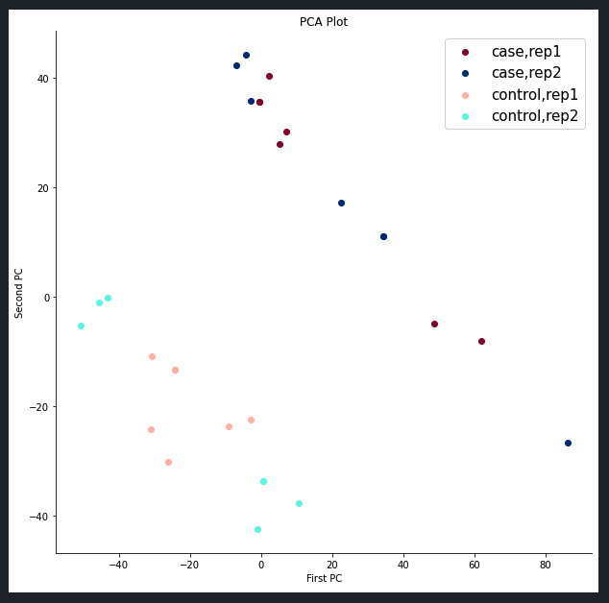
Non-Class Specific Batch Correction
Class Specific Batch Correction
Subpopulation: Patient 2 and 8

Slide 10
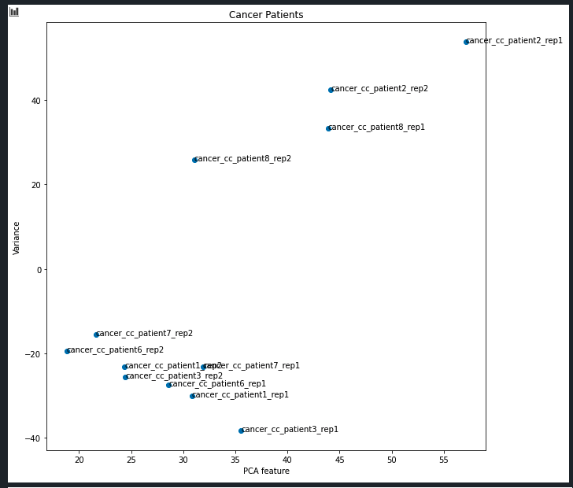
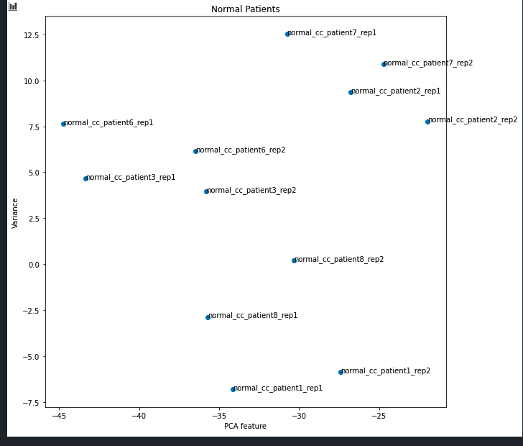
Non-Class Specific Batch Correction
Cancer Patients
Control Patients

Slide 11
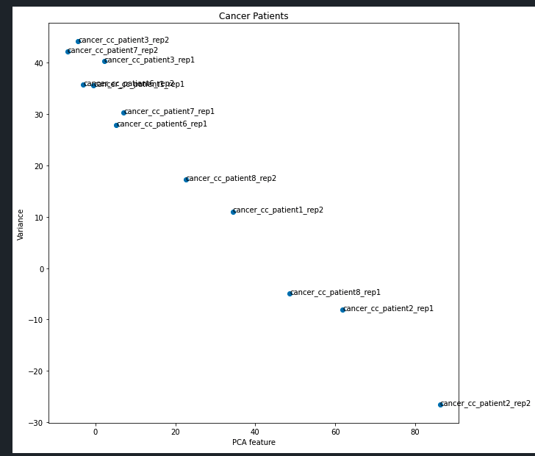
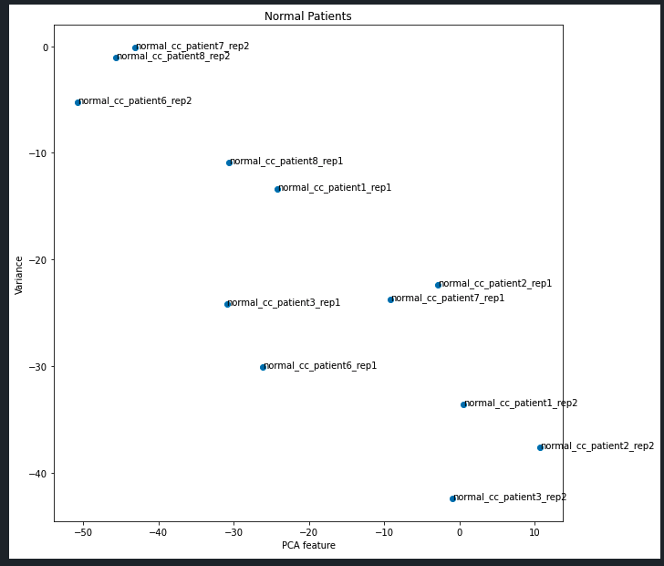
Class Specific Batch Correction
Cancer Patients
Control Patients

Slide 12
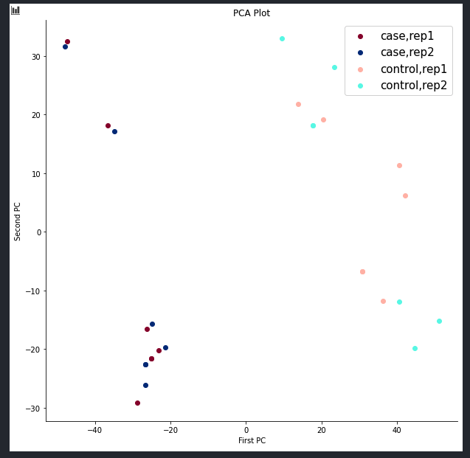
Class Specific Quantile Normalization + Class Specific Batch Correction

Slide 13
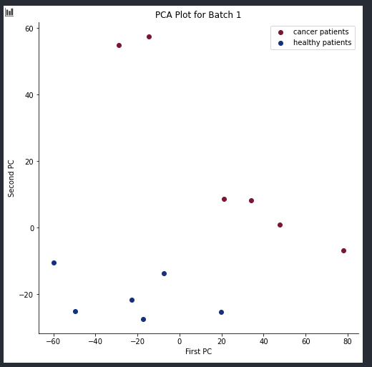
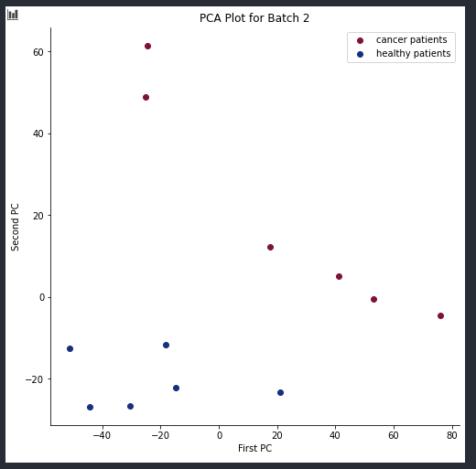
PCA plot for Batch 1
PCA plot for Batch 2

Slide 14
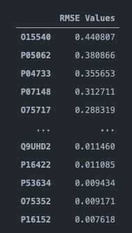
Genes most affected by class specific batch correction

Slide 15
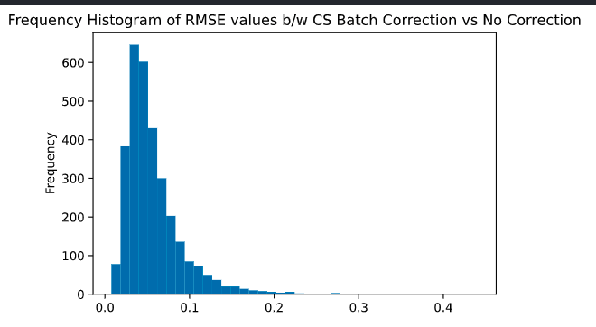
Distribution of RMSE values between CS Batch Correction versus No Correction

Slide 16
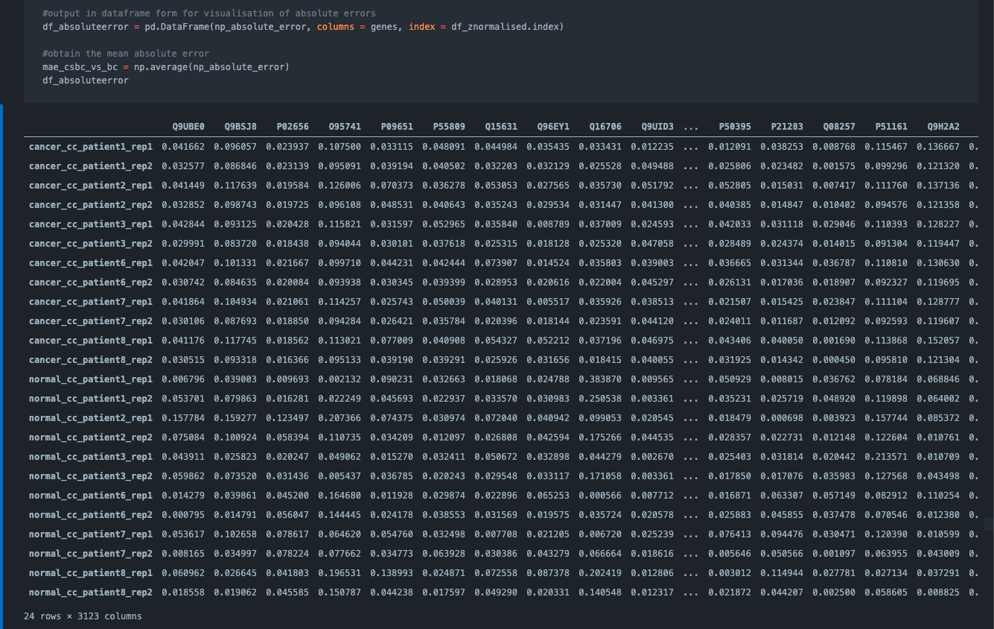
Mean Absolute Error (Non Class Specific versus Class Specific Batch Corrected Data)
Average Error = 0.05702117420523973

Slide 17
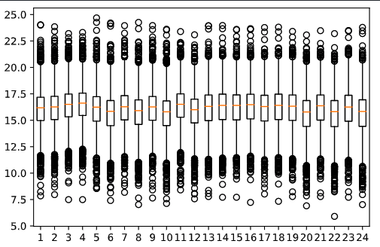
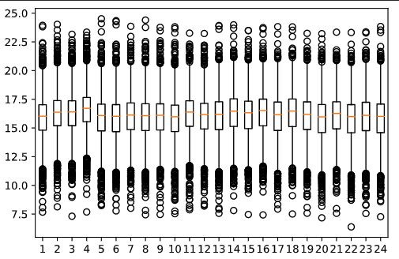
Box plots of “No Batch Correction” versus “Class Specific Batch Correction”
No Batch Correction
Class Specific Batch Correction

Slide 18
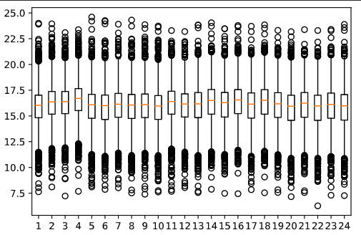
Box plots of Non-Class Specific Correction versus Class Specific Batch Correction
Non-Class Specific Batch Correction
Class Specific Batch Correction
Effects of batch correction looks similar in non-class specific or class specific

Slide 19
Comparison between non-class specific batch correction and
class specific batch correction
Non-Class Specific
Batch Corrected
Before MTC: 1770
After MTC: 486
Enriched: 69
Class Specific
Batch Corrected
Before MTC: 1747
After MTC: 480
Enriched: 44
Intersections between batch corrected and class specific batch corrected
Intersections
Proteins (After MTC) and Enriched Pathways that are the same between batch corrected and class specific batch correction
After MTC: 471
Enriched: 40

Slide 20
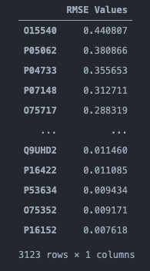
Genes most affected by class specific batch correction

Slide 21
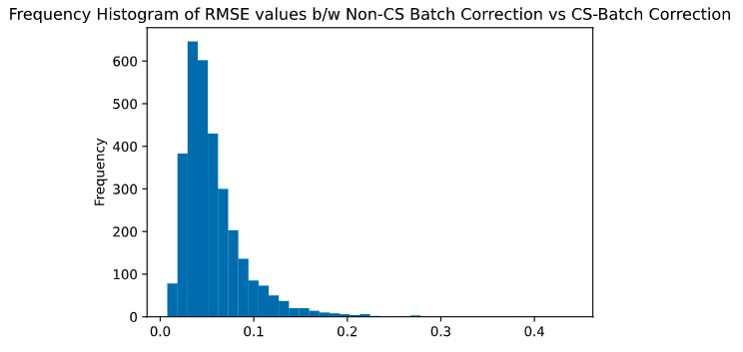
Distribution of RMSE values between CS Batch Correction versus Non-CS Batch Correction (RMSE by genes: 3123 RMSE values)

Slide 22
Comparison between non-class specific batch correction and
class specific batch correction
Non-Class Specific
Batch Corrected
Before MTC: 1770
After MTC: 486
Enriched: 69
Class Specific
Batch Corrected
Before MTC: 1747
After MTC: 480
Enriched: 44
Intersections between batch corrected and class specific batch corrected
Intersections
Proteins (After MTC) and Enriched Pathways that are the same between batch corrected and class specific batch correction
After MTC: 471
Enriched: 40

Slide 23
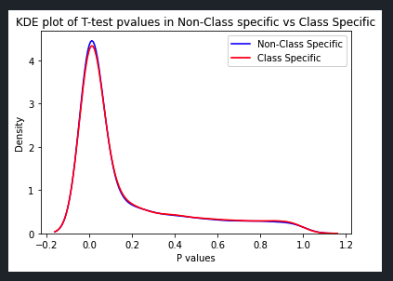
P value distribution
Post-MTC (Bonferroni) p-value distribution of the protein genes
0.05702117420523973

Slide 24
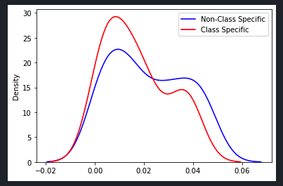
P value distribution
P-value distribution of enriched pathways protein genes
Class Specific Batch Correction = more genes carrying lower range P-values
As expected, class specific batch correction enhance class effect**

Slide 25
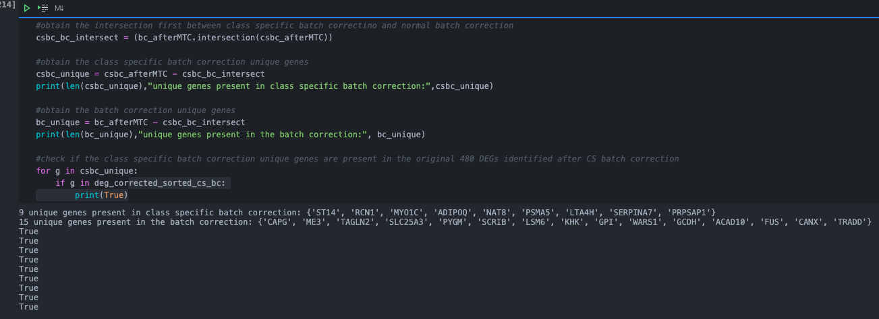
The 9 genes that are not reported in intersection = potentially brought out by class specific batch correction
Checked the presence of these 9 genes in the original 480 class specific batch corrected DEGs
ALL 9 genes were present ***

Slide 26
Takeaways
PCA was able to separate non-class specific batch corrected data
PC1 allowed for separation by case and control
PC2 allowed for less distinct separation (compared to PC1) between case and control
PC2 also allowed for separation of potential case subpopulations (3 clusters)
PCA was only able to separate class specific batch corrected data with the combination of both PC1 and PC2
PC1 and PC2 individually was unable to separate case and control distinctly
PCA allowed for separation between case and control for CS quantile + CS batch corrected data distinctly
Class specific batch correction enhanced class effects as expected

